Slide 1

IBM
AICTE PROJECT
Email - ID : ag0292@srmist.edu.in
Student Name : Arnav Gupta
College Name : SRM University Delhi-NCR Campus

Slide 2
Table of contents
Problem Statement
Technology used
Wow factor
End users
Result
Conclusion
Git-hub Link
Future scope
IBM Certifications

Slide 3
Problem Statement
Problem Statement No.14 Syllabus and Curriculum Design Optimizer
The Syllabus and Curriculum Design Optimizer is an AI tool that helps faculty create and improve course content of Machine Learning subject in SRM University. It analyzes syllabi, suggests improvements, aligns topics with learning outcomes, and generates draft syllabi. It automates tasks like mapping outcomes and updating reading lists, saving time and enhancing curriculum quality.
Problem Solution
Implement a Watsonx AI assistant (Granite model) with integrated search tools (Google, DuckDuckGo, Wikipedia, Document Search). This AI will analyze the existing syllabus, research current trends, and provide automated recommendations for topic updates, outcome alignment, resource updates, and assessment strategies, streamlining the process and improving curriculum quality.

Slide 4
Technology Used
IBM cloud lite services
Natural Language Processing (NLP)
Retrieval Augmented Generation (RAG)
IBM Granite model
IBM Cloud Service Used
IBM Cloud Watsonx AI Studio
IBM Cloud Watsonx AI runtime
IBM Cloud Agent Lab
IBM Granite foundation model

Slide 5
Wow Factor
Transform your curriculum development with the Syllabus Optimizer AI, designed to dramatically reduce faculty workload, enhance syllabus quality, ensure alignment with learning outcomes, and foster innovation in course design.
Key features include:
AI-powered syllabus analysis: Identify areas for improvement and potential gaps.
Automated content recommendations: Discover relevant topics, readings, and assessments.
Learning outcome alignment: Ensure seamless integration of course content with objectives.
Up-to-date trend integration: Incorporate the latest academic and industry advancements.
Draft syllabus generation: Create comprehensive syllabi in minutes.
Streamlined formatting and updates: Automate repetitive tasks for maximum efficiency.

Slide 6
End User
Faculty/Professors
Instructional Designers
Department Chairs/Heads
Curriculum Committees
Accreditation Teams
New Faculty Members
Teaching Assistants (TAs)

Slide 7
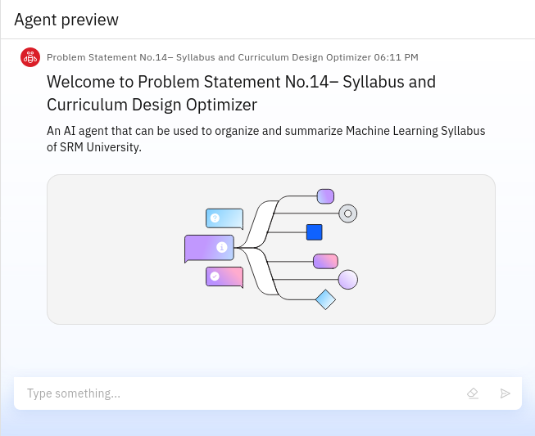
Result

Slide 8
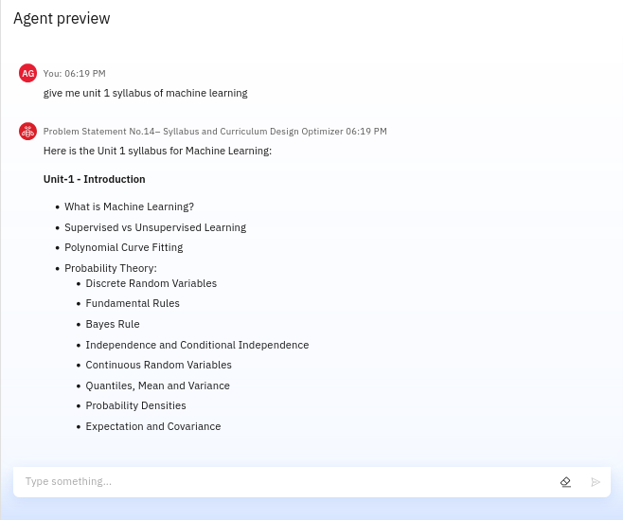
Result

Slide 9
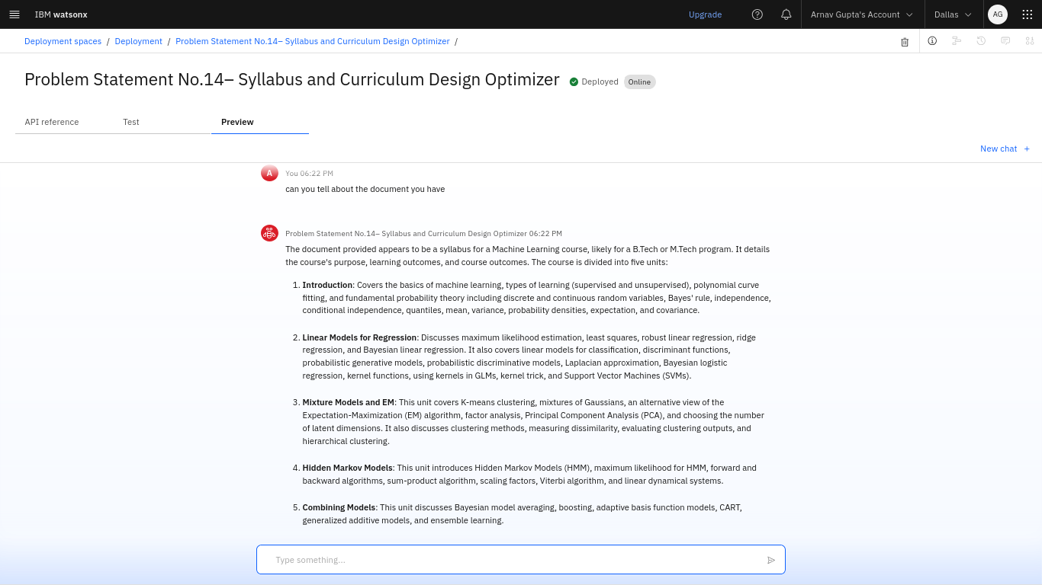
Result - Deployed Agent

Slide 10
Conclusion
The Syllabus Optimizer AI generates draft syllabi, recommends content updates, and ensures alignment with learning outcomes. It saves time by automating repetitive tasks like formatting and updating reading lists. Syllabus Optimizers enhance efficiency, consistency, and innovation in curriculum development across academic programs.

Slide 11
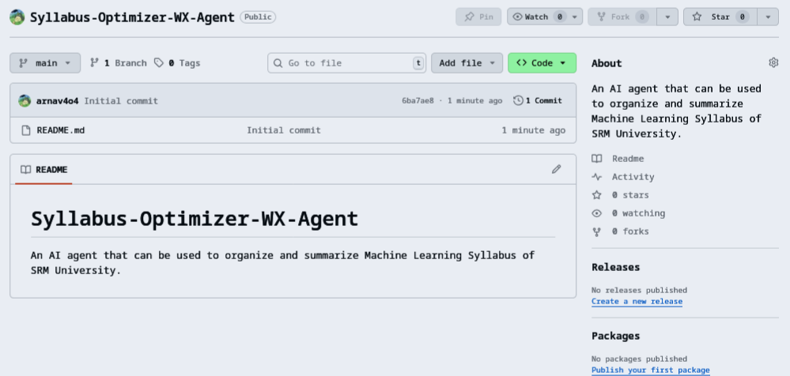
Github Link : https://github.com/arnav4o4/Syllabus-Optimizer-WX-Agent

Slide 12
Future Scope
Personalized learning paths
AI-driven assessment generation
Real-time feedback integration
Expanded data sources
Multilingual support
Accessibility tool integration
Predictive analytics for success

Slide 13
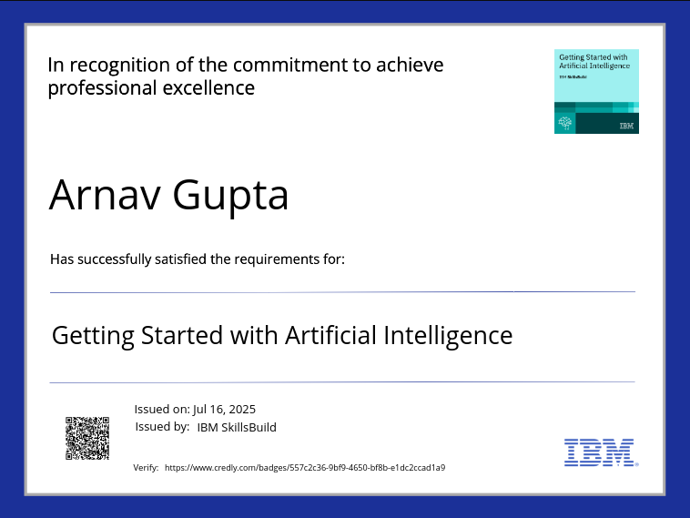
IBM Certificates
Getting Started
with Artificial Intelligence

Slide 14
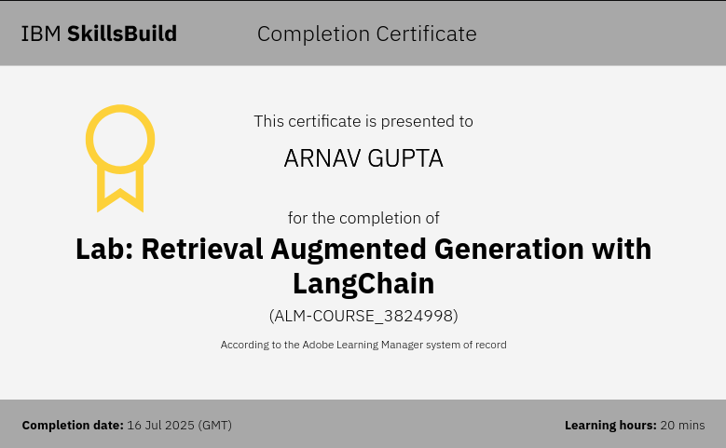
IBM Certificates
Lab :
Retrieval Augmented Generation with LangChain

Slide 15
THANK
YOU

